Slide 1


MI-TW 2021聯測介紹
WG2-Vital Signs
召集人：台灣醫學影像資訊標準協會 林欣怡
聯繫窗口：中原大學生物醫學工程所碩士班 洪苑容
2021-05-21

Slide 2
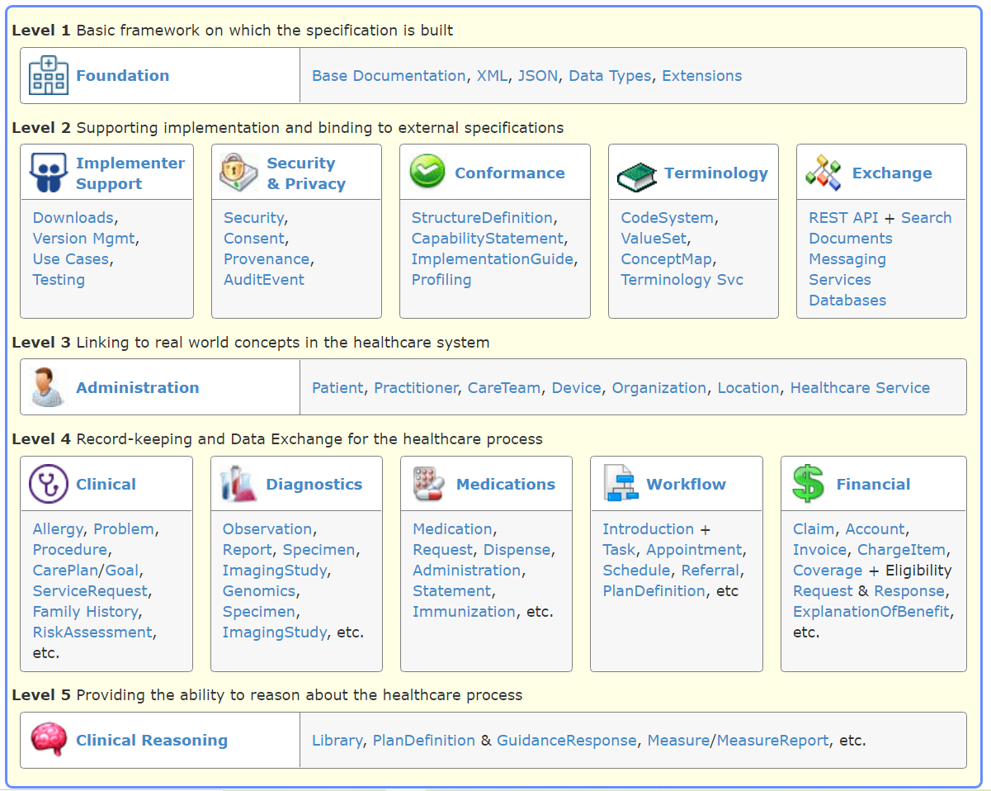
Vital Sign
Laboratory
Device measurements
Imaging results
Personal characteristics
Social history
Clinical assessment tools
Core characteristics
Notes:
Medication statement 病人用藥紀錄

Slide 3



Scenarios I
使用者(病患)自行上傳生理監測數據
PHR(Personal Health Record)或院內FHIR SERVER
照護者端下載及呈現生理監測數據
Post observation
get observation
Vital signs
Body Weight
Body Height
Body Temperature
Pre Meal / Post Meal
Heart Rate
Percentage of Body Fat Measured
Grip Strength Hand-Dynamometer
Laboratory
Blood Glucose
http://hapi.fhir.org/baseR4/Observation?code=29463-7&subject=402
FHIR Server RootURL
resource
code
patient

Slide 4
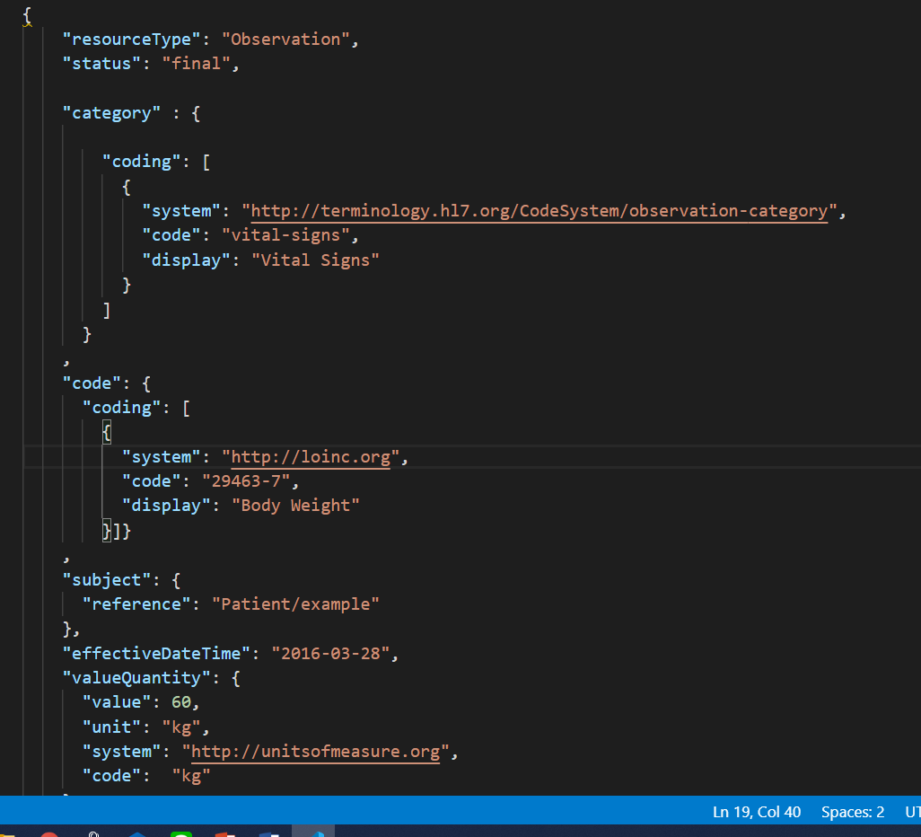
Scenarios I

Slide 5
Scenarios I_Code&Unit
Item | LoincCode | Unit
Body Height | 3137-7 | cm
Body weight | 29463-7 | kg
Blood Pressure Panel | 35094-2 | mmHg
Systolic Blood Pressure | 8480-6 | mmHg
Distolic Blood Pressure | 8462-4 | mmHg
Body Temperature | 8310-5 | Cel
Blood Glucose Post Meal | 87422-2 | mg/dL
Blood Glucose Pre Meal | 88365-2 | mg/dL
Heart Rate | 8867-4 | {beats}/min
Percentage of body fat Measured | 41982-0 | %
Grip strength Hand - right Dynamometer | 83174-3 | kg

Slide 6
Scenarios II
Imaging results in hospital : bone density
測量部位:測量腰椎(spine bone)、髖骨(Hip)或股骨(Femur)
量測結果以 T-score 呈現
新增note: 標註詳細部位

Slide 7
掛號
1.1Post patient WG1
1.2Post encounter
4.1get patient
4.2get serviceRequest
2.1get patient
4.3get observation
診間看診
開立檢驗單
回診間看結果
2.2 post encounter
4.4Post diagnosticReport
2.3 post condition
2.4 post serviceRequest
3.1 get serviceRequest
3.2 post encounter
3.3 put serviceRequest
3.4 post observation
檢查室做檢查
Notes:
我也聽步道

Slide 8
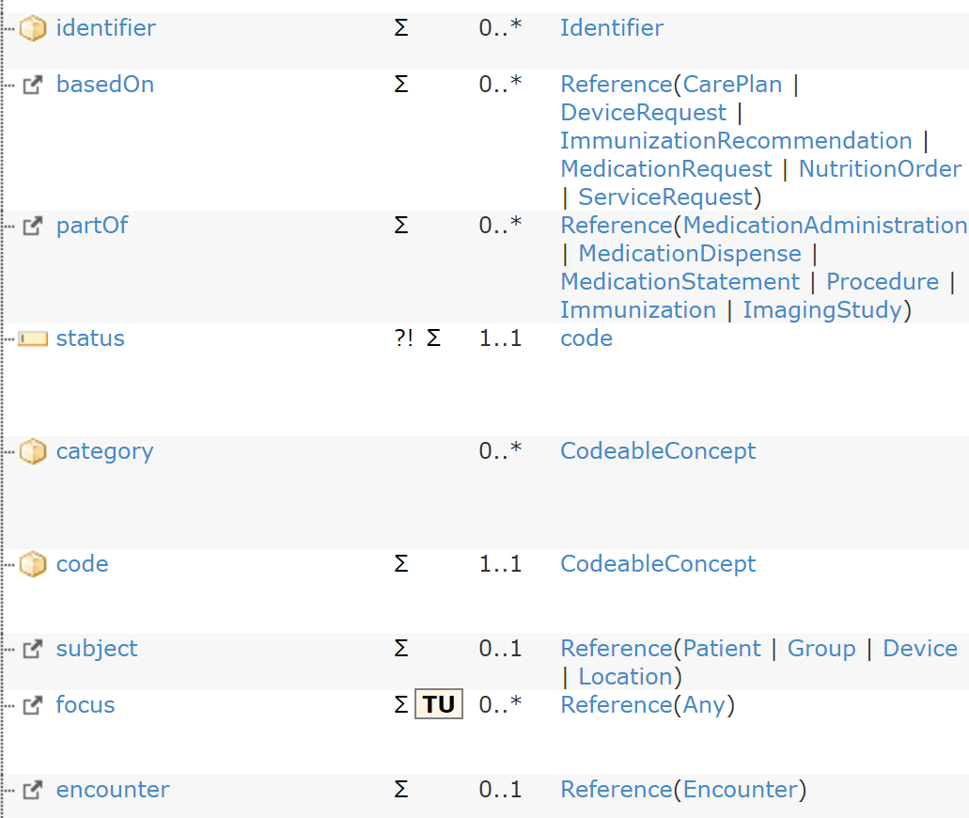
Example 2
final
Code system https://www.hl7.org/fhir/codesystem-observation-category.html
Code: image
"system": "http://loinc.org",
"code": "80953-3",
“display”: “DXA Femur - right [Mass/Area] Bone density”

Slide 9
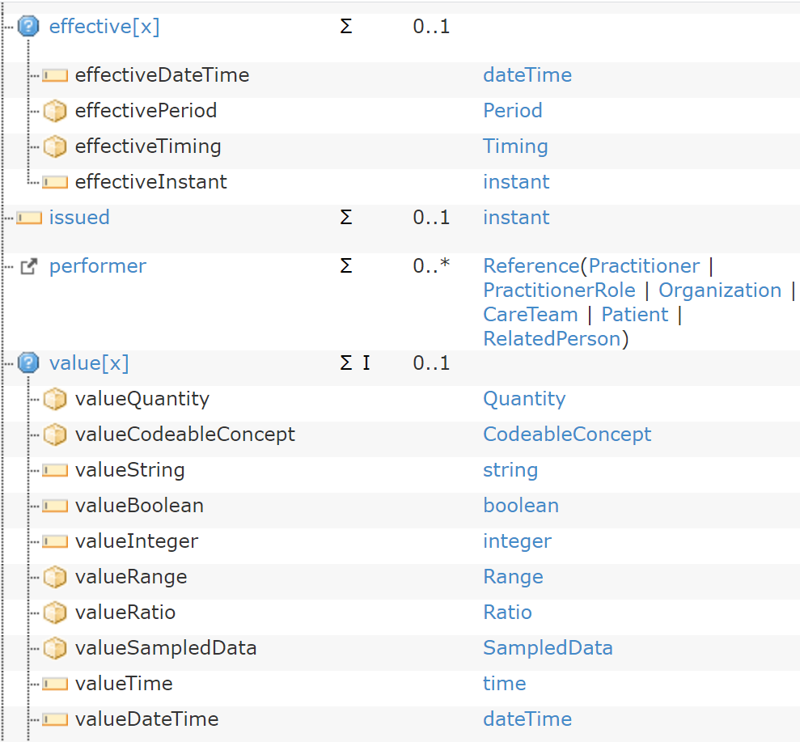
"valueQuantity":
value: -1.1
Unit : T-score
system : "http ://unitsofmeasure.org"
"code": {T-score}

Slide 10
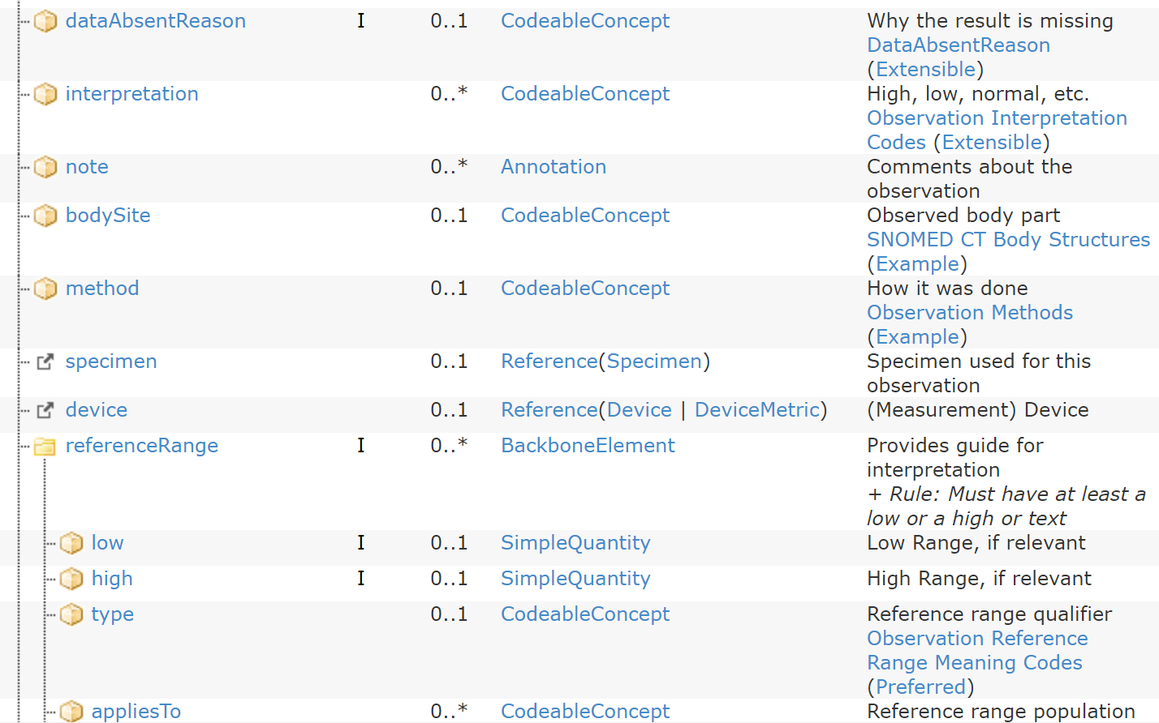
EX: Lumbar spine L1

Slide 11
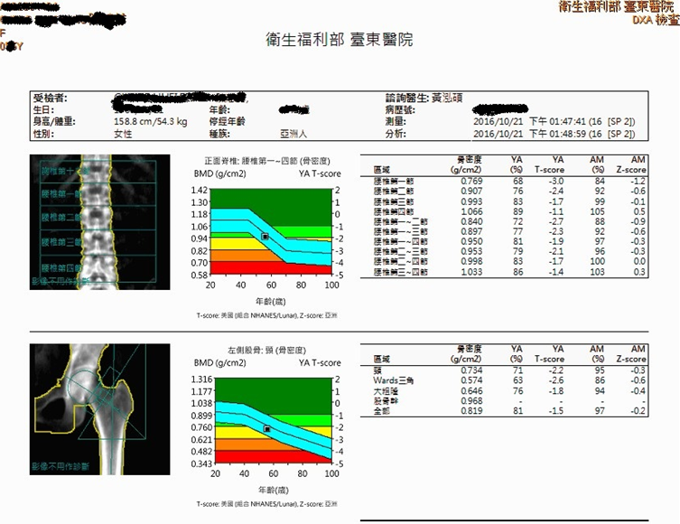
放在note

Slide 12
Scenarios II_Code&Unit
Item | LoincCode | Unit
DXA Femur [T-score] Bone density(股骨) | 38263-0 | {T-score}
DXA Femur - left [T-score] Bone density | 80948-3 | {T-score}
DXA Femur - right [T-score] Bone density | 80947-5 | {T-score}
DXA Lumbar spine [T-score] Bone density(脊椎) | 38267-1 | {T-score}
DXA Hip [T-score] Bone density(髖骨) | 38264-8 | {T-score}

Slide 13
Scenarios II_Note
部位 | Note
腰椎第一節 | Lumbar spine L1
腰椎第二節 | Lumbar spine L2
腰椎第三節 | Lumbar spine L3
腰椎第四節 | Lumbar spine L4
腰椎第二節 | Lumbar spine L1~L2
腰椎第二節 | Lumbar spine L1~L3
腰椎第二節 | Lumbar spine L1~L4
腰椎第二節 | Lumbar spine L2~L3
腰椎第二節 | Lumbar spine L2~L4
腰椎第二節 | Lumbar spine L3~L4
股骨頸 | Femoral neck
Ward三角 | Ward`s area
股骨幹 | Femoral body
股骨全部 | Total Femur

Slide 14
Scenarios III-Query
上傳blood pressure+heart rate
新增baseOn_MedicationRequest=62114
查詢blood pressure +heart rate + medicationRequest
(時間區間:2012-07-01T00:00:01至2012-07-31T23:59:59)
WG2成員事先上傳medicationRequest，提供查詢區間為2020-05-01T00:00:01至2021-05-01T23:59:59

Slide 15
掛號
1.1Post patient WG1
1.2Post encounter
2.1get patient
4.1Get patient
2.2 post encounter
4.2Get medicationRequest
2.3 post practitioner
4.3Get condition
診間看診
開立處方籤
定期回診
4.3 Get observation
2.4 post medicationRequest
(開立慢性處方簽)
4.4Post diagnosticReport
4.5Post medicationRequest
3.1 post condition
3.2 post observation
回家，每天早晚量血壓新律、定時吃藥

Slide 16
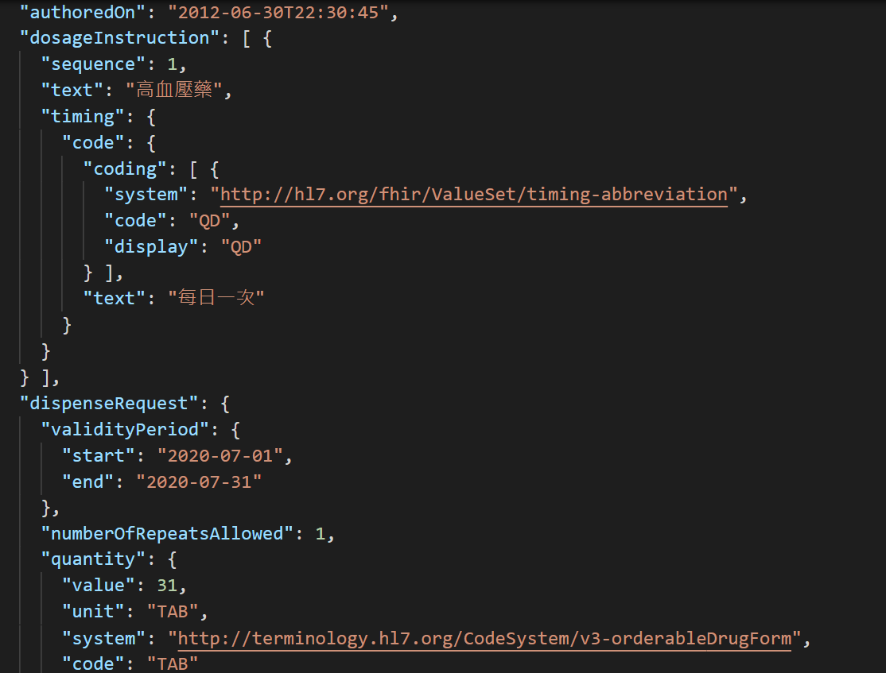
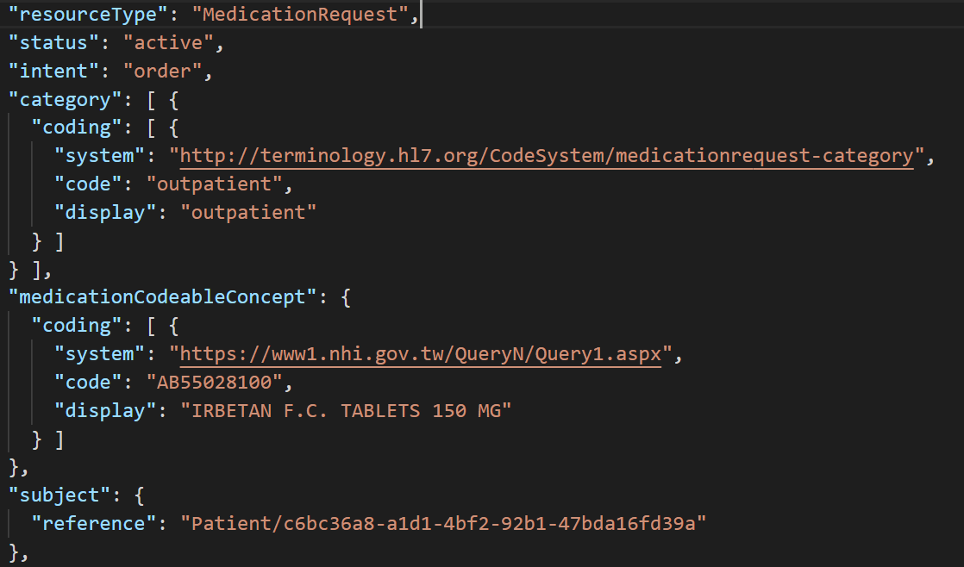
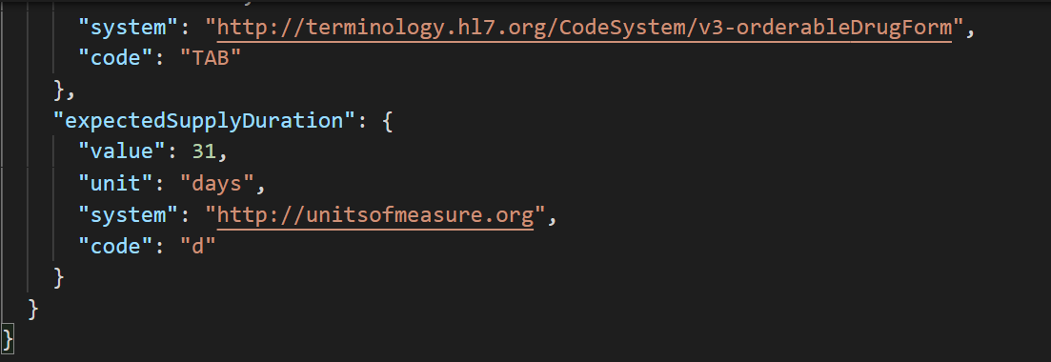
用藥方式
病人類型
配藥期間
藥物資訊
配藥總量
配藥天數

Slide 17
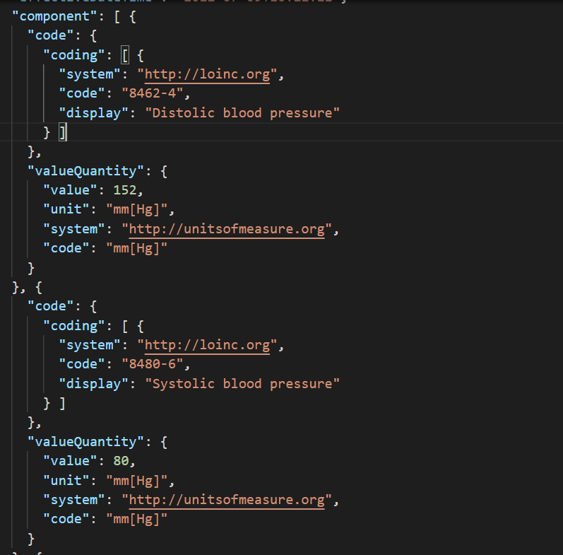
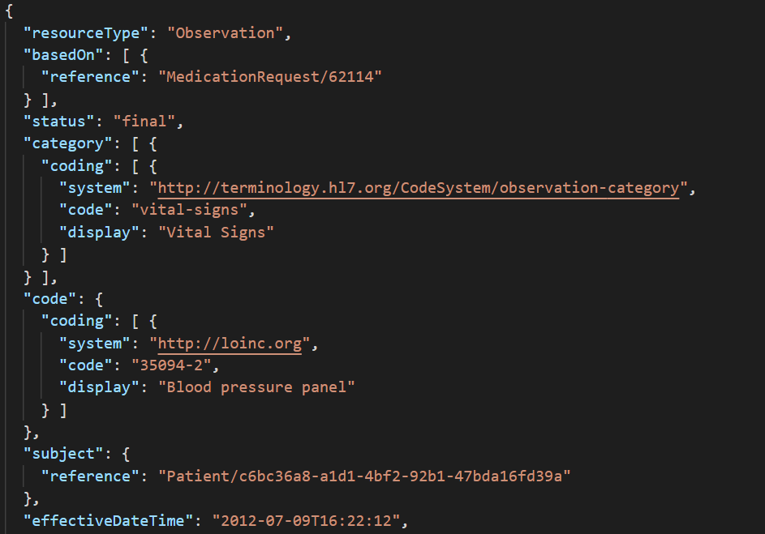
FHIR Observation_ basedOn

Slide 18
Observation.code_LOINC CODE
Item | LoincCode | Unit
Blood Pressure Panel | 35094-2 | mmHg
Systolic Blood Pressure | 8480-6 | mmHg
Distolic Blood Pressure | 8462-4 | mmHg
Heart Rate | 8867-4 | {beats}/min

Slide 19
Query
查詢病人某日血壓資料
https://fhir.dicom.tw/fhir/Observation?code=35094-2&subject= c6bc36a8-a1d1-4bf2-92b1-47bda16fd39a &date=2012-07-01
查詢特定病人某段時間血壓資料
https://fhir.dicom.tw/fhir/Observation?code=35094-2&subject= c6bc36a8-a1d1-4bf2-92b1-47bda16fd39a & date=gt2012-07-01T00:00:01&date=lt2021-07-05T23:59:59
查詢特定病人處方簽資料
https://fhir.dicom.tw/fhir/MedicationRequest?subject= c6bc36a8-a1d1-4bf2-92b1-47bda16fd39a
查詢特定病人處方簽與血壓、心律的資料
https://fhir.dicom.tw/fhir/Observation?subject=c6bc36a8-a1d1-4bf2-92b1-47bda16fd39a&based-on=63757&code=8867-4,35094-2&date=gt2020-07-05T00:00:01&date=lt2020-07-10T23:59:59

Slide 20
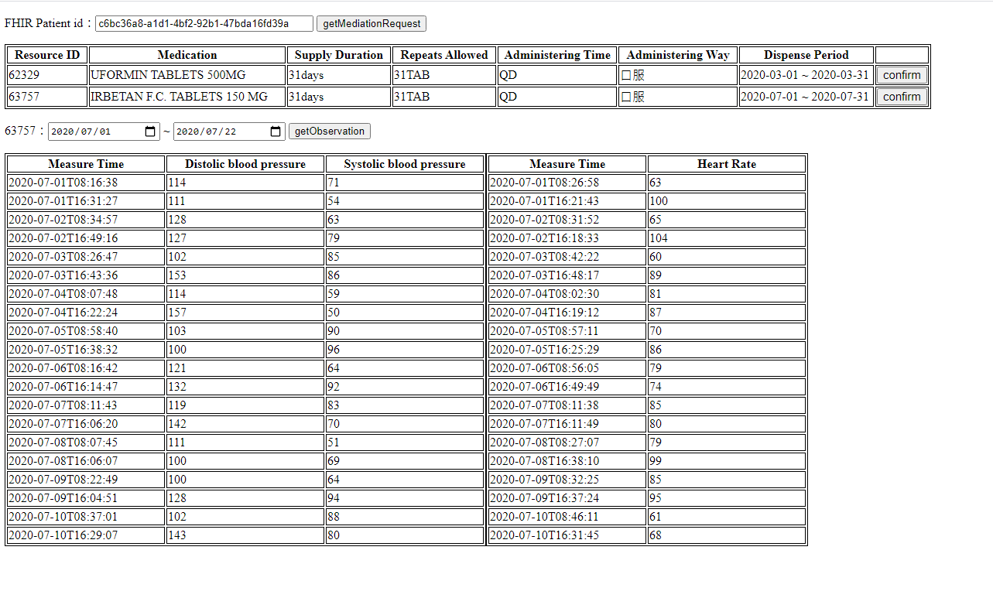
用藥+血壓+心律的呈現
https://alicehong-grass.github.io/MedicationRecord/

Slide 21
Scenarios VI-12-lead ECG
院內上傳12-lead ECG
院外上傳12-lead ECG
(12-lead ECG or wearable ECG device)
呈現12-lead ECG

Slide 22
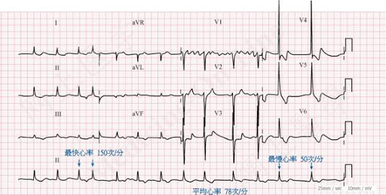
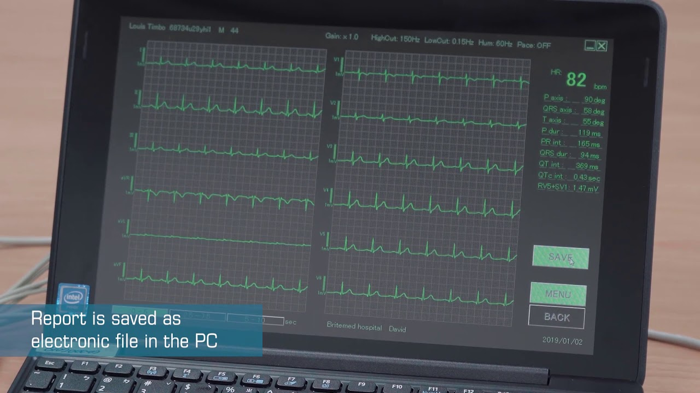
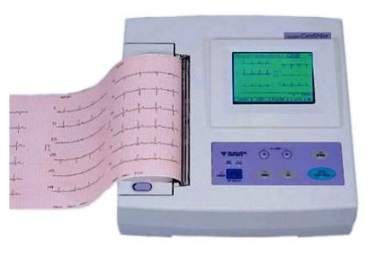

Slide 23
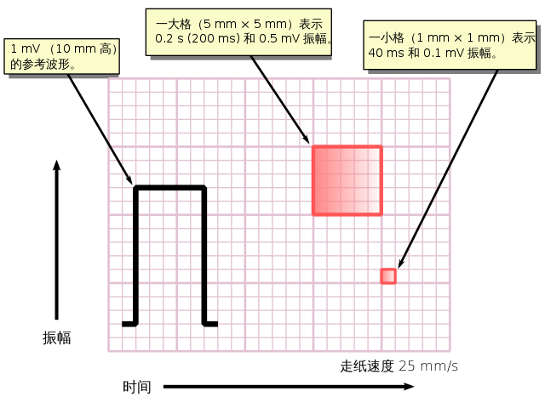
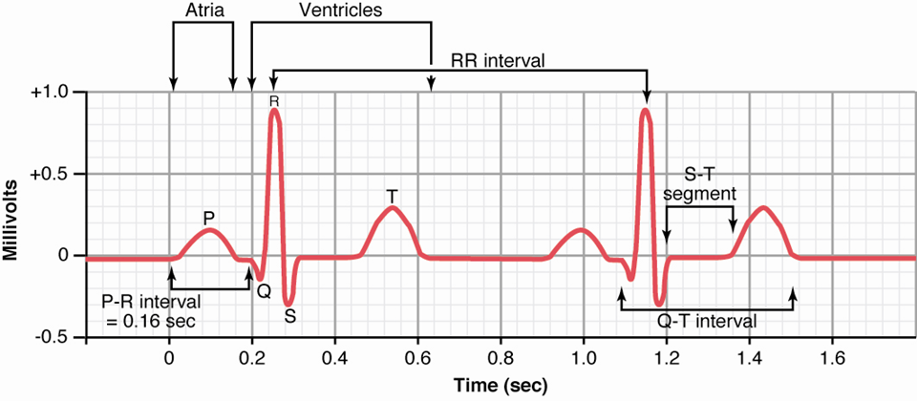

Slide 24
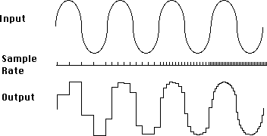
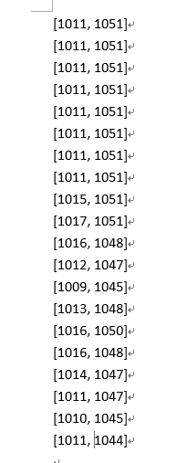
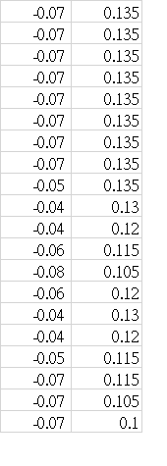
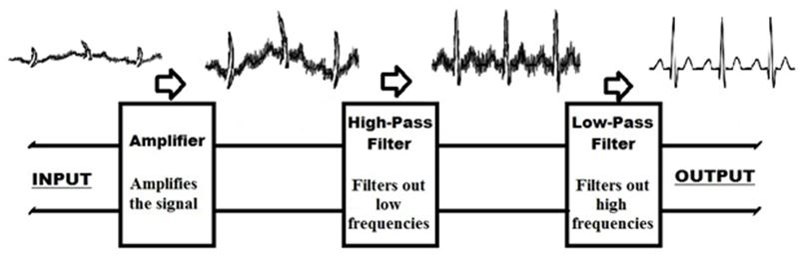
sampling
output的data
原始量測出的data(mV)
Amplifier
Filter

Slide 25

FHIR Server
Device
Waveform Data +annotation
User side Browser
經過gateway轉譯
轉換成FHIR ECG
醫師向FHIR server 查詢調閱

Slide 26
ECG Device
Observation.Component.value(waveform data)
Observation.Component.value(annotation)
gateway
1.資料量太大，不利傳輸
2.不利醫師查詢 annotation 或 AI inference result
Observation
(Waveform data)
Http Post
FHIR Server
gateway
Derived from
ECG Device
Observation
(Annotation)

Slide 27
Procedure of 12 Lead ECG in Hospital
Registered Center
Report Creator
5.5Post DiagnosticReport
5.1Get Patient
5.2Get ServiceRequest
1.1Post Patient
5.3Get Observation(waveform)
1.2Post Encounter
5.4Get Observation(findings)
4.1 Get ServiceRequest
4.2Post Encounter
FHIR SERVER
4.3 Get ECG Observation
(Waveform)
Order Placer
AI or Evidence Creator
2.1Get Patient
4.4Put ECG Observation
(annotation)
4.5Post ECG Observation(findings)
2.2Post Encounter
2.3Post Condition
3.2Put ServiceRequest
2.4Post ServiceRequest
3.3Post Encounter
3.1Get ServiceRequest
3.4Post ECG Observation(waveform)
3.5Post ECG Observation(annotation)
Gateway
ECG Device
Notes:
ICU: base on Alert

Slide 28
Procedure of Out patient’s 12 Lead ECG or Wearable ECG with ServiceRequest
Registered Center
Report Creator
5.5Post DiagnosticReport
5.1Get Patient
5.2Get ServiceRequest
1.1Post Patient
5.3Get Observation(waveform)
1.2Post Encounter
5.4Get Observation(findings)
4.1 Get ServiceRequest
4.2Post Encounter
FHIR SERVER
4.3 Get ECG Observation
(Waveform)
Order Placer
AI or Evidence Creator
2.1Get Patient
4.4Put ECG Observation
(annotation)
4.5Post ECG Observation(findings)
2.2Post Encounter
2.3Post Condition
2.4Post Patient (with unique outpatient ID)
2.4Post ServiceRequest
3.1Post ECG Observation(waveform)
3.2Post ECG Observation(annotation)
Gateway
ECG Device
Notes:
ICU: base on Alert

Slide 29
Procedure of Out patient’s 12 Lead ECG or Wearable ECG without ServiceRequest
Report Creator
3.4Post DiagnosticReport
3.1Get Patient(or Get Device)
3.2Get Observation(waveform)
3.3Get Observation(findings)
1.1Post Patient
3.1Get Patient
1.2Post Device
FHIR SERVER
3.2 Get ECG Observation
(Waveform)
Registered
AI or Evidence Creator
3.3Put ECG Observation
(annotation)
3.4Post ECG Observation(findings)
2.1Post ECG Observation(waveform)
2.2Post ECG Observation (annotation)
Wearable/
ECG Device
Notes:
ICU: base on Alert

Slide 30
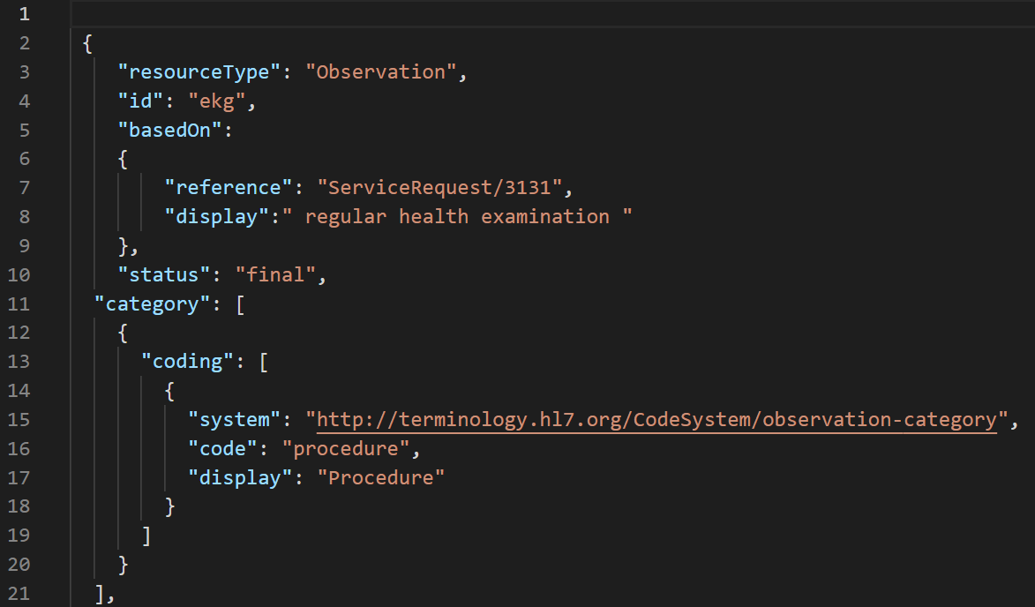
Notes:
我聽得到 可以

Slide 31
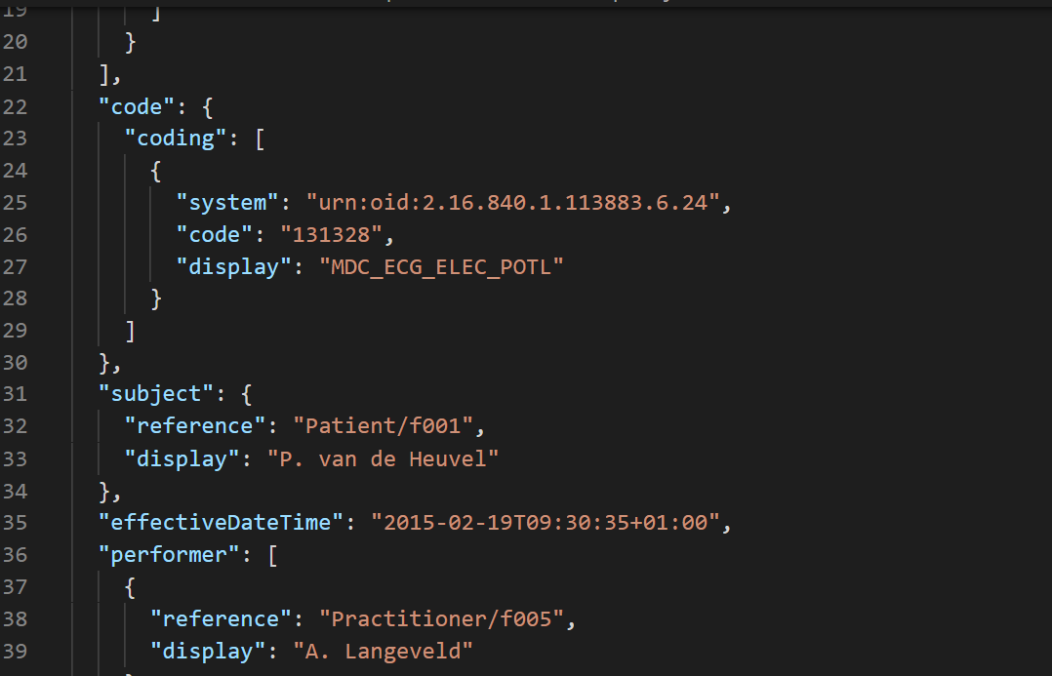
ISO/IEEE 11073 Health informatics

Slide 32
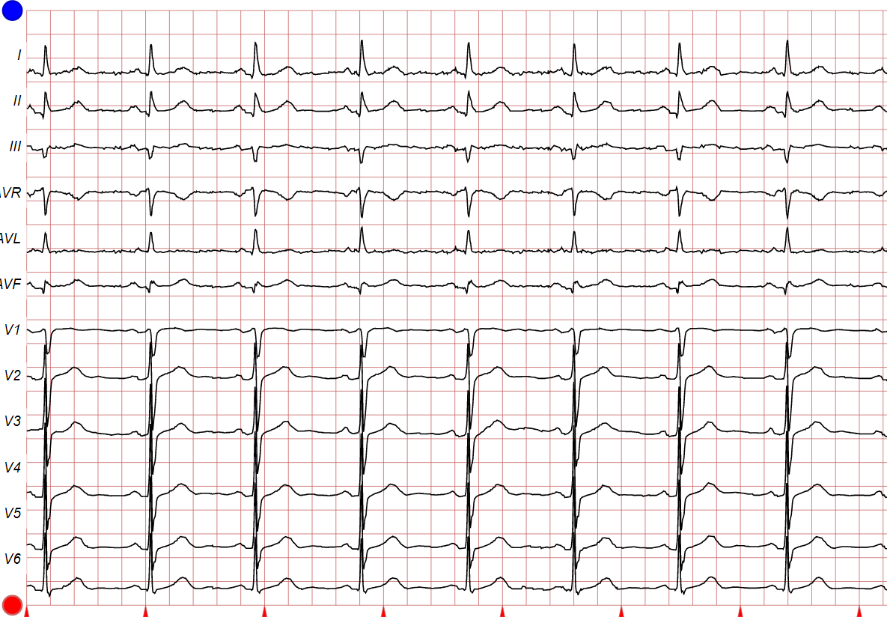
FHIR 12 Lead ECG
FHIR Observation
Component
Lead I
Lead II
Lead III
Lead AVR
Lead AVF
Lead AVL
Lead V1-V6

Slide 33
IEEE 11073 12 Lead ECG Code
Code | Display
131328 | MDC_ECG_ELEC_POTL
131329 | MDC_ECG_ELEC_POTL_I
131330 | MDC_ECG_ELEC_POTL_II
131389 | MDC_ECG_ELEC_POTL_III
131390 | MDC_ECG_ELEC_POTL_AVR
131391 | MDC_ECG_ELEC_POTL_AVL
131392 | MDC_ECG_ELEC_POTL_AVF
131331 | MDC_ECG_ELEC_POTL_V1
131332 | MDC_ECG_ELEC_POTL_V2
131333 | MDC_ECG_ELEC_POTL_V3
131334 | MDC_ECG_ELEC_POTL_V4
131335 | MDC_ECG_ELEC_POTL_V5
131336 | MDC_ECG_ELEC_POTL_V6

Slide 34
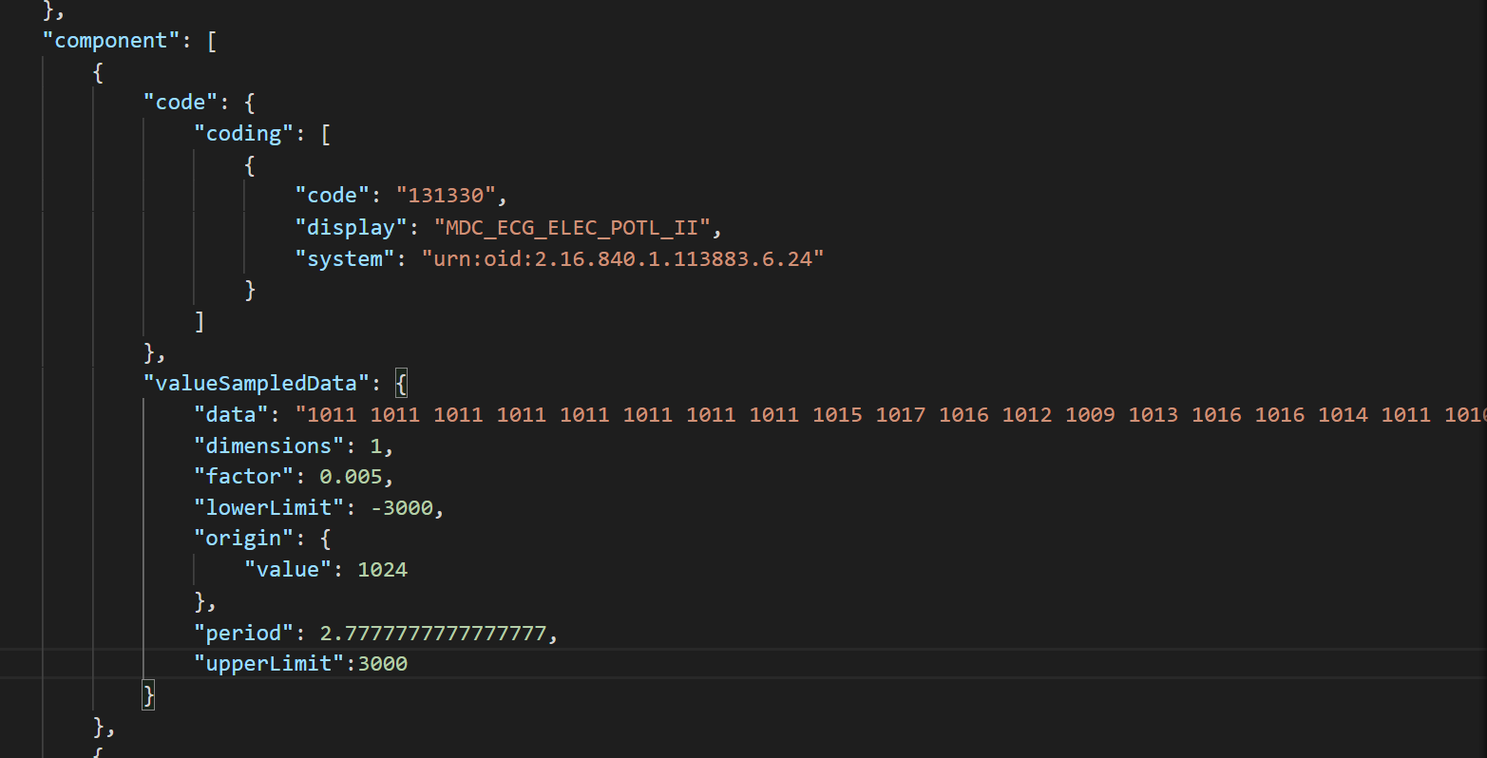
ECG Lead II

Slide 35
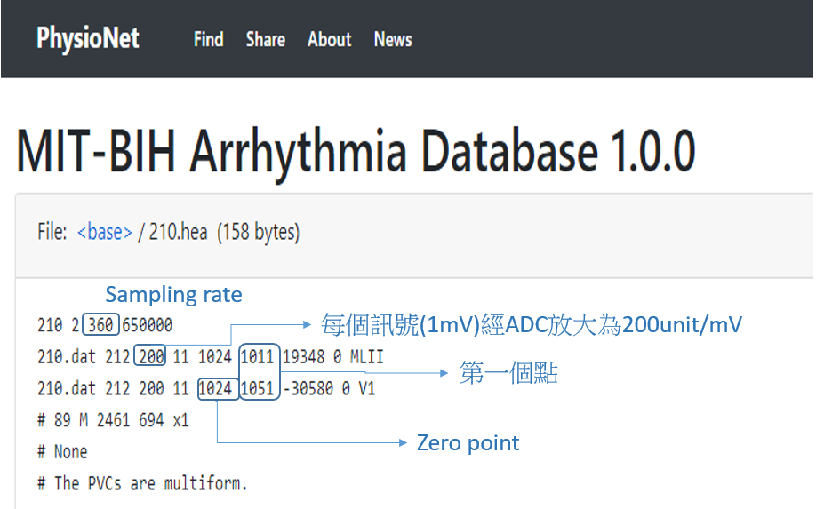
Sampled data
original | 原始零點的數值 | 1024
Period | 每組資料裡每個取樣點間隔的時間單位為million second | Sampling Rate:360HZ 1000ms/360點 period=2.77ms
Factor | 經ADC後的值*Factor =原始值(mV) | 1/200=0.005 (1011-1024)*0.005=- 0.07mV
Lowerlimit | The lower limit of detection of the measured points. This is needed if any of the data points have the value "L" (lower than detection limit).
Upperlimit | The upper limit of detection of the measured points. This is needed if any of the data points have the value "U" (higher than detection limit).
Dimensions | 一組資料裏面包含了幾個導程的訊號 Ex: 訊號：V1,V2,V1,V2,V1,V2….，Dimension=2 | 1
data | A series of data points which are decimal values separated by a single space.

Slide 36
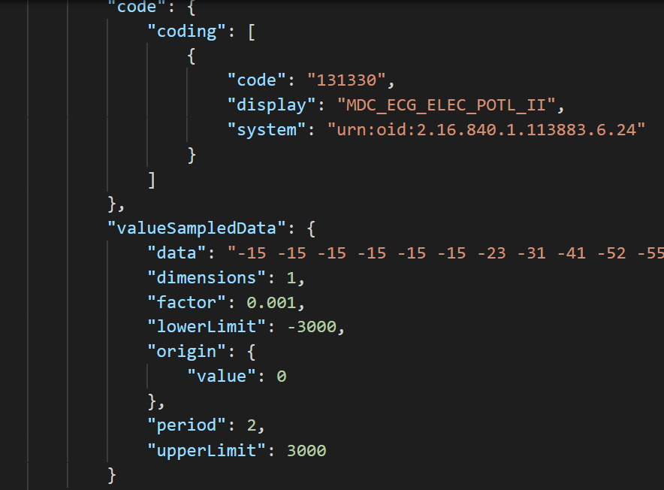
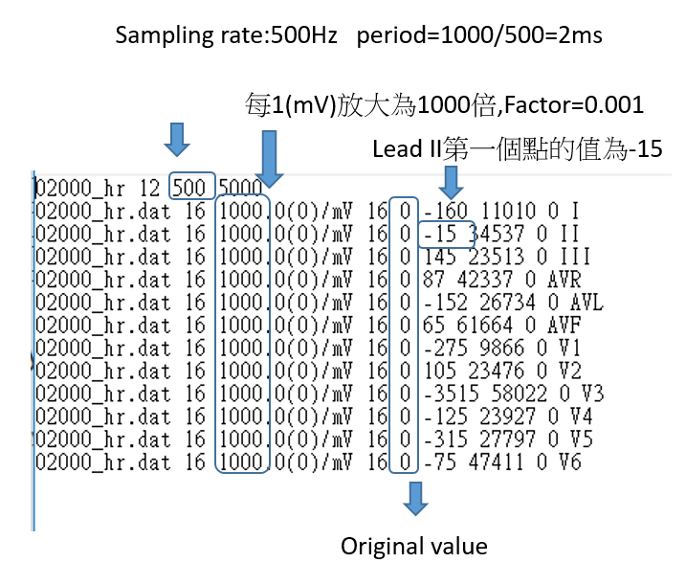
PTB-XL ECG database

Slide 37
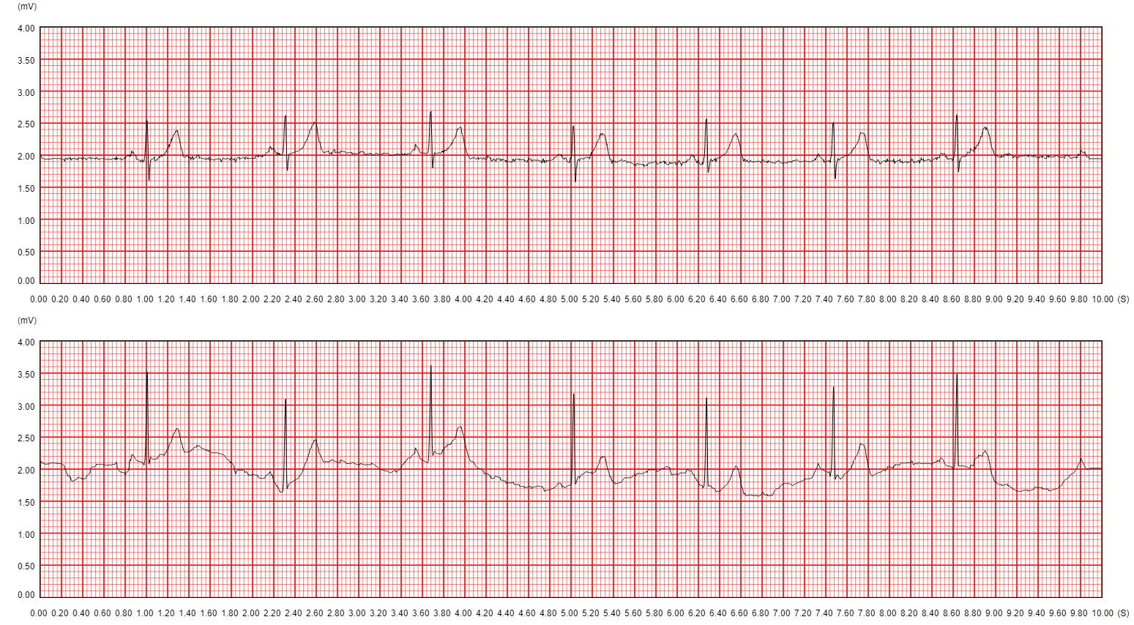
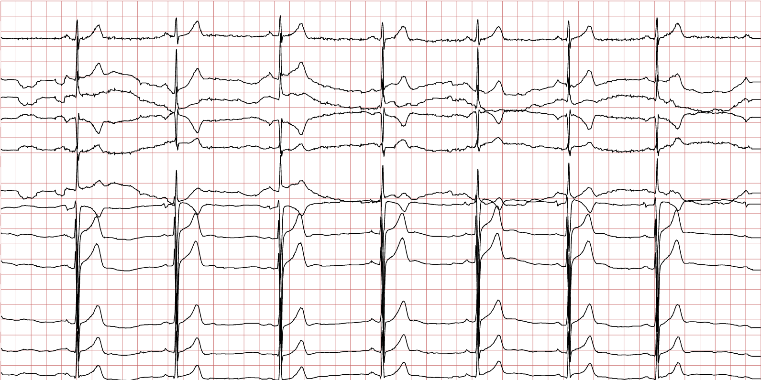
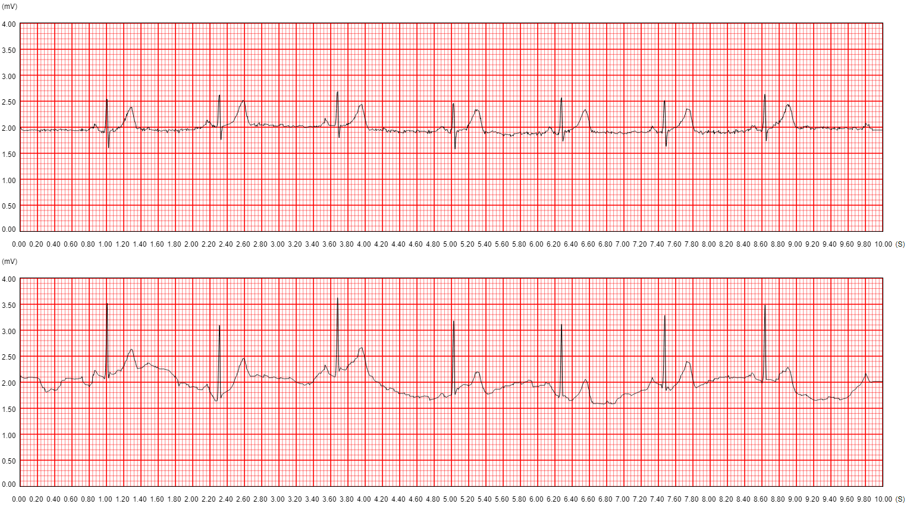
Viewer
Notes:
http://203.64.84.150:38088/viewer

Slide 38
Scenarios V-Vital Signs in EMS
救護車到達現場，或是在救護車上，上傳各式生理監測資料一次

Slide 39
EMS center
Hospital
1.1 post patient
2.1 get patient
ambulance center
FHIR Server
ambulance
3.1 put patient
4.1 post condition
3.3 post condition
4.2 post encounter
3.2 post encounter
4.3 post carePlan/medication/procedure…etc.
3.4 post Questionnaire
4.4 post observation 2
3.5 post observation1
Contact Site

Slide 40
 |  | category | code | Unit(UCUM)
頸動脈?脈搏(HR) | Heart Rate | Vital-signs | 8867-4(Loinc) | {beats}/min | LOINC Code 8889-8 Heart rate by Pulse oximeter
體溫(BT) | Body temperature | Vital-signs | 8310-5(Loinc) | cel
BP(血壓) | Blood Pressure Panel | Vital-signs | 35094-2(Loinc) | mmHg
 | Systolic Blood Pressure | Vital-signs | 8480-6(Loinc) | mmHg
 | Distolic Blood Pressure | Vital-signs | 8462-4(Loinc) | mmHg
呼吸頻率RR | Respiratory Rate | Vital-signs | 9279-1(Loinc) | {breaths}/min; {counts/min}
spO2脈搏血氧飽和濃度 | pulse oximetry | Vital-signs | 59408-5(Loinc) | % | https://loinc.org/59408-5/
EKG | EKG data | Procedure | 131328(IEEE 11073)
微血管充填時間 | Capillary refill Time | exam | 44963- 7 (Loinc) | s | Capillary refill [Time] of Nail bed
血糖 | blood glucose | laboratory | 2339-0 | mg/dL | https://loinc.org/2339-0/

Slide 41
final
Patient ID
現場/救護車上

Slide 42
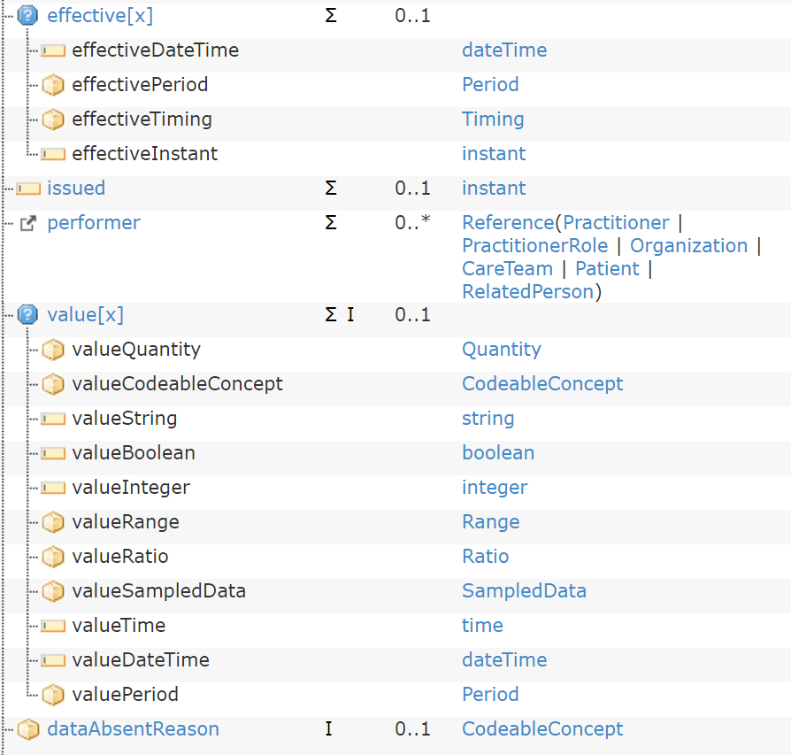
spO2

Slide 43
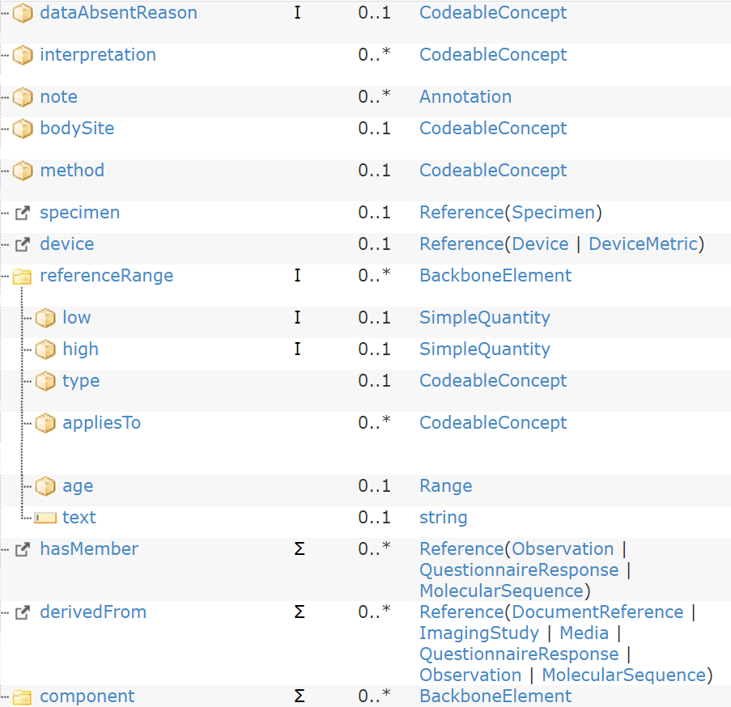
第一次量測/第二次量測

Slide 44
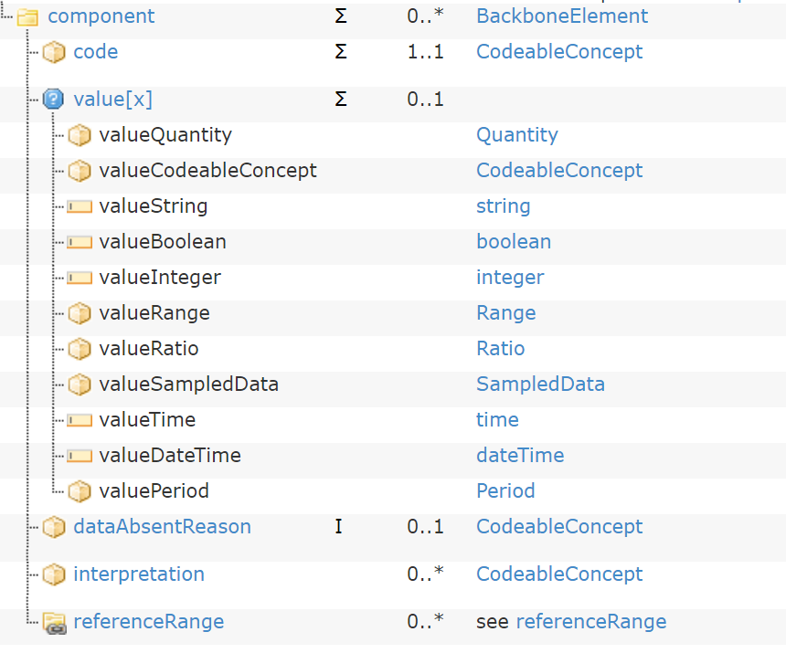
Blood Pressure
EKG

Slide 45
Thank You

